Slide 1
INCOMING 1ST YEARS 2023

Slide 2
Fáilte
Mr Michael McMahon Principal
Mr John Hegarty Deputy Principal
Mrs Hanna Turner (1st Year 2023-24)Year Head
Ms Leanne Goff Guidance Counsellor
Mr John Nolan Digital Coordinator
Mr Fearghal Davey E learning Coordinator
Beryl Furlong - Wriggle

Slide 3
Information Required
Forms required (to be returned by Wednesday 29th March)
School Record Form*
Code of Behaviour Form *
Acceptable Use Policy Form *
Acceptable Use Policy (E-Mail) Form *
School Trip Permission Form *
Circular 0023/2016-Data Collection Form *
Sensitive Personal Data Form *
Guidance and Learning Support Consent Form *
Other Information Online
Transition Issues Booklet (uploaded in file section)
Incoming Information Booklet (uploaded in file section)
Junior Cycle Subject Factsheet Booklet (uploaded also)
Subject Choice Form (to be filled in online)

Slide 4
KEY POLICIES
Code of Behaviour
Anti-bullying Policy
R.S.E. Policy
Acceptable Use Policy
Acceptable Use Policy (E-Mail)
www.wexfordcbs.ie

Slide 5
First Year 2022/2023
120 Students
Four core classes/ 30 students per class
JCP-Junior Cycle Programme
Subjects-
English
Irish
Maths
History
Geography
Religion
+ 3 optional subjects

Slide 6
Junior Cycle
8 exam subjects
3 short courses (P.E., C.S.P.E., S.P.H.E)
Formal Certification - Junior Cycle Profile of Achievement – RESULTS IN THESE SUBJECTS PLUS OTHER AREAS OF LEARNING
Wellbeing – (Made up of P.E., C.S.P.E., S.P.H.E., Guidance)

Slide 7
School Day (Monday-wednesday)
8:50am-Classes begin -2 x 1hr classes in morning before break
10.50am-11.05am-Morning Break
11.05am-1.05pm-2 x 1hr- Mid-morning classes
1.05pm-1.45pm-Lunch Break
1.45pm-3:45pm-2 x 1hr Afternoon Classes
3.45pm- Home

Slide 8
School day (THURSDAY-FRIDAY)
8:50am-Classes begin -2 x 1hr classes in morning before break
10.50am-11.05am-Morning Break
11.05am-1.05pm-2 x 1hr- Mid-morning classes
1.05pm-1.45pm-Lunch Break
1.45pm-2:45pm- 1hr Afternoon Class
2.45pm- Home

Slide 9
School Day continued
First Year students are not allowed to leave the school premises at any time during the school day unless accompanied by a teacher or parent/guardian (Rule applies to all Junior Cycle students)
Those wishing for son to go home for lunch must collect the student on a daily basis-No exceptions
REASON FOR ABSENCE/NOTIFICATION OF APPOINTMENT ON VSWARE
MOBILE PHONES ARE NOT ALLOWED FROM 8.50AM-3.45PM

Slide 10
FEES 2023/2024
ALREADY PAID
REMAINING
First Year Fee €120
(Covering the following)
Lending Scheme €40
Printing Fee €20
School Journal €10
Administration Fee €50
Voluntary Contribution €80 (or €80 per family)
August 2023(Online)
School Pitch €30 or €50 for family August 2023 (Online)
Lockers €15 collected by Parents’ Council online
All Payments-Easy Payments Plus (tab on school website) www.wexfordcbs.ie

Slide 11
Uniform
Black Shoes
Navy Trousers
Pale Blue Shirt
Grey Jumper with School Crest
Navy tie with pale blue stripe
School Jacket (Various options available-O'Neill's website or local stores)
Good idea to have a backup uniform
Parents of those who arrive out of uniform will be contacted to bring their son home

Slide 12
School Transport
All queries re school transport should be directed to Bus Éireann on 051 873401 or e-mail schools.waterford@buseireann.ie.
To apply, go to www.buseireann.ie/schooltransport and follow links and submit form or alternatively download and submit by post to Waterford School Transport Office, Bus Eireann, The Quay, Waterford. You need to know the school’s roll number: 63640R.
DES Phone 057 9325466/7 or e-mail school.transport@education.gov.ie For more details go to www.education.ie
Eligibility for new entrants will be determined by reference to the distance they reside from their nearest Post Primary Education Centre (4.8km minimum distance)

Slide 13
Book Lending Scheme
Book Lending Scheme to cover: English/Irish/Maths/Classics /Visual Art/Technical Graphics/Wellbeing/Religion books and lab. copy for Science, Maths Graph copy and Log tables. Irish magazines and library fee for History/English.
Calculator/Mathematical set/Art sketch pads not covered
Onus on students to take care of the books as damaged/lost books will have to be replaced.
Only purchase books for subjects that your son is studying

Slide 14
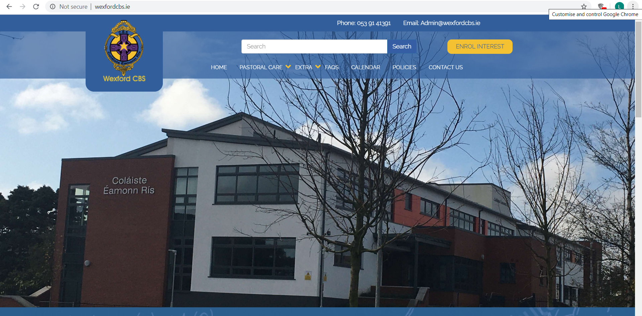
COMMUNICATION
VS Ware/Text Alert
Parents to sign off on absences,
appointments etc.
-Monitor attendance, behaviours,
results
- Journal - Newsletter - www.wexfordcbs.ie - Twitter - (@wexCBS) - Instagram - (@wexfordcbs) - Facebook - (Wexford CBS) - DES Website - (education.ie)

Slide 15
Assessment information
CAT 4
Use to inform us about your son’s strengths across a number of competencies
Was scheduled for April 22nd /Now will be held in early September
Primary School Educational Passports (forwarded by Primary Schools)

Slide 16
Further Communication
Notification in May/June regarding subject options
Notification in mid-August regarding return to school dates etc.
October Meeting for First Year Parents

Slide 17
Learning Support
Ms. Marie Connell (Learning Support Co-ordinator)
Ms Ailbhe Darcy (ASD Unit)
If you have a professional psychological assessment, please send a copy in as soon as possible(not original)

Slide 18
Reminder
Forms required (to be returned by Wednesday 29th March)
School Record Form*
Code of Behaviour Form *
Acceptable Use Policy Form *
Acceptable Use Policy (E-Mail) Form *
School Trip Permission Form *
Circular 0023/2016-Data Collection Form *
Sensitive Personal Data Form *
Guidance and Learning Support Consent Form *
Subject Choice Form (to be filled in online by Wed 29th March)

Slide 19
The role of the Year Head
Hanna Turner

Slide 20
Pastoral – wellbeing & Holistic development
To coordinate a network of services to facilitate the individual pupil to achieve their maximum potential.
Student Support Team – Guidance Counsellor, Special Educational Needs Coordinator, Principal, Deputy Principal
Tutor team
Class Teachers
Parents
Check & Connect (Mentors & Mentees)
Attendance Committee
Meitheal Leaders
Extracurricular teams/ clubs
Support services outside of school

Slide 21
Restorative – Fostering inclusion & positive relationships
Affirmation of positive behaviour to promote self esteem.
To oversee and investigate incidents/ issues that may occur and maintain good relationships and order in the year group.
a) Wellbeing b) Positive Behaviour c) Academic tracking d) Attendance e) Punctuality f) Uniform g) Journal & Study.
Collaboration occurs with;
Students
Teachers
Parents
Restorative Justice Committee
Positive Affirmation Committee
Attendance Committee
Tutor Team
Guidance & Student Support Team

Slide 22
communication - Belonging to & Involvement in school
To ensure information is conveyed to the year group and any relevant referrals.
Encourage participation & involvement within the school community
Microsoft Teams
Assemblies
VSWare
Email
Meetings/ Notifications to parents and/or relevant teams, committees, Deputy Principal, Principal.
Extracurricular activities; Sports, Performance Arts, Volunteering opportunities , Flag initiatives (Green, Amber), Chess club, Debating club, Enterprise etc…

Slide 23
CAREER GUIDANCE & COUNSELLING
Leanne Goff - Guidance Counsellor
“True guidance is like a small torch in a dark forest. It does not show everything at once, but gives enough light for the next step to be safe”

Slide 24
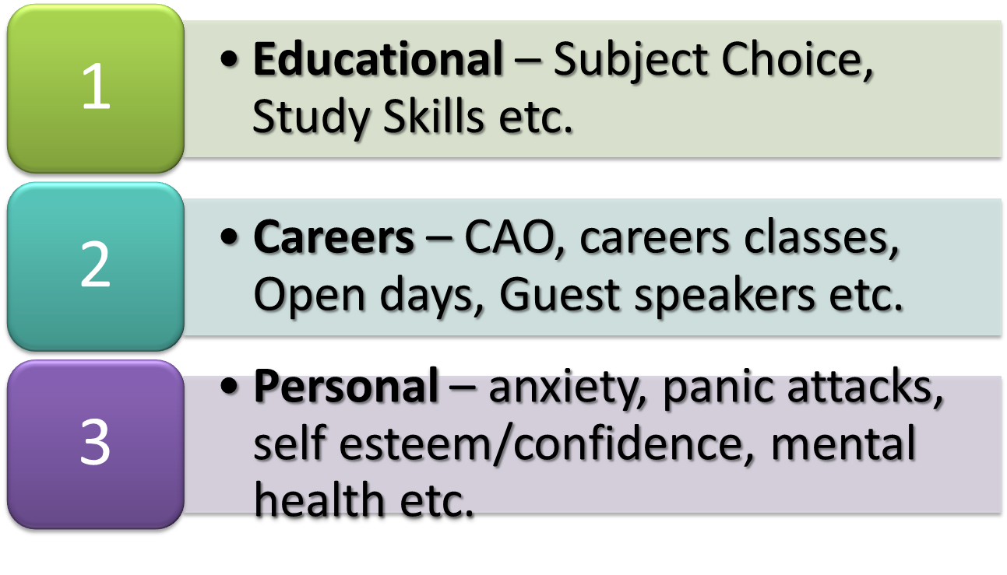
ROLE OF THE GUIDANCE COUNSELLOR:

Slide 25
CONFIDENTIALITY:
Confidentiality can be kept but secrecy cannot. What is said in the counsellor's office will not be passed on without students' permission, unless;
someone is being hurt (either hurting themselves, someone else or being hurt by someone)
is in danger or
is involved in something illegal.
Legally Ms Goff must pass on this type of information to the Principal.

Slide 26
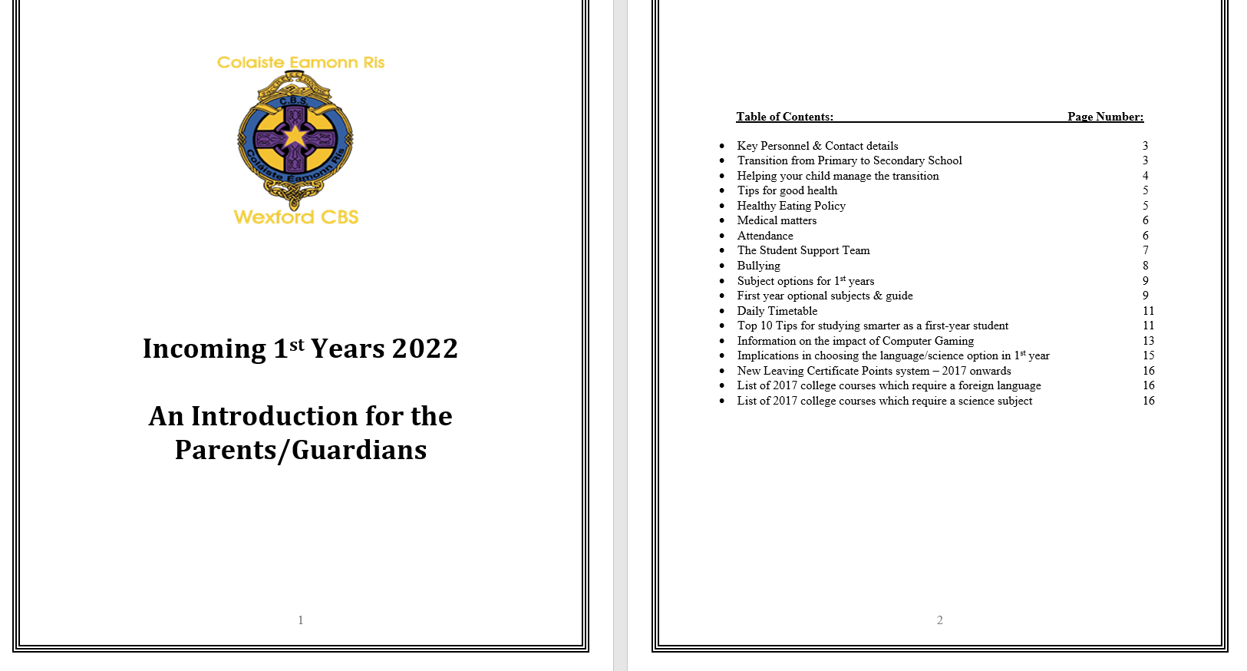
BOOKLETS:
General info. Re: transition, health, attendance, student support.
Student subject options.
Tips for smarter studying.
Info. on computer gaming & the effects.
Issues surrounding language/science options & info on college courses requiring same.
New LC Points scheme – 2017 onwards.

Slide 27
TRANSITION (PRIMARY – SECONDARY):
Triple transition:
1. From very familiar school environment to much larger school and new subjects

Slide 28
TRANSITION (PRIMARY – SECONDARY):
Triple transition:
2. From one set of peer group and friends to another peer group

Slide 29
TRANSITION (PRIMARY – SECONDARY):
Triple transition:
3. From childhood to adolescence.

Slide 30
TRANSITION (PRIMARY – SECONDARY):
Significant change – new friends, teachers, subjects, environment.
Longer day.
Organisation is paramount.
Increased timetable & more homework.
Opportunities for extracurricular activity.
Preparation for state exams.

Slide 31
HOW TO MANAGE TRANSITION:
Timetable and Homework journal.
Routine and schedule.
Quiet place with no distractions.
Check journal each night and sign.
Discuss their day in school.
Approximately 1.5 hours homework/study a night.
Reports ONLINE after Christmas & Summer tests.
Parent-Teacher meeting.
* Important Study tips in booklet

Slide 32
DECISION TIME:
The subjects you pick will help you to develop the Junior Cycle Key Skills.
The Guidance Counsellors will outline the career implications of subject choice.
Rest assured – the limitations are few.

Slide 33
SUBJECT CHOICE:
CORE SUBJECTS
NON-CORE SUBJECTS
Irish
English
Mathematics
History
Geography
Religious Education (RE)
Wellbeing (CORE):
-Civic, Social & Political Education (CSPE)
-Physical Education (PE)
-Social, Personal & Health education (SPHE)
-Career Guidance
-Computer Studies
-Tutor
Visual Art
Business Studies
Classics
Music
Wood Technology
French
German
Science
Technical Graphics

Slide 34
SCIENCE SUBJECTS & FOREIGN LANGUAGES:
A decision not to do science or a modern language(French/German) will have implications on the range of courses/careers open to you later on.

Slide 35
3rd LEVEL MODERN LANGUAGE REQUIREMENT:
NUI Universities;
- UCC,
UCD,
NUI Galway,
NUI Maynooth.
Also:
St. Angela’s College, Sligo
National College of Art & Design (NCAD)
Royal College of Surgeons (RCSI)
Shannon College of Hotel Management
Defence Forces Cadetship

Slide 36
COURSES YOU MAY NEED 1 OR 2 SCIENCE SUBJECTS FOR:
Science
Engineering
Medicine
Dentistry
Veterinary
Pharmacy
Physiotherapy
Radiography
Nursing
Occupational Therapy
Speech Therapy
Med. Lab. Science
Dietetics
Optometry

Slide 37
To summarise:
There are very few courses that you need for 3rd Level Entry;
- Science
Modern Language

Slide 38
JUNIOR CYCLE INFORMATION:
Information on the new Junior Cycle (Framework, Subjects & Short Courses) can be found at:
www.ncca.ie/en/junior-cycle
https://www.jct.ie/home/home.php

Slide 39
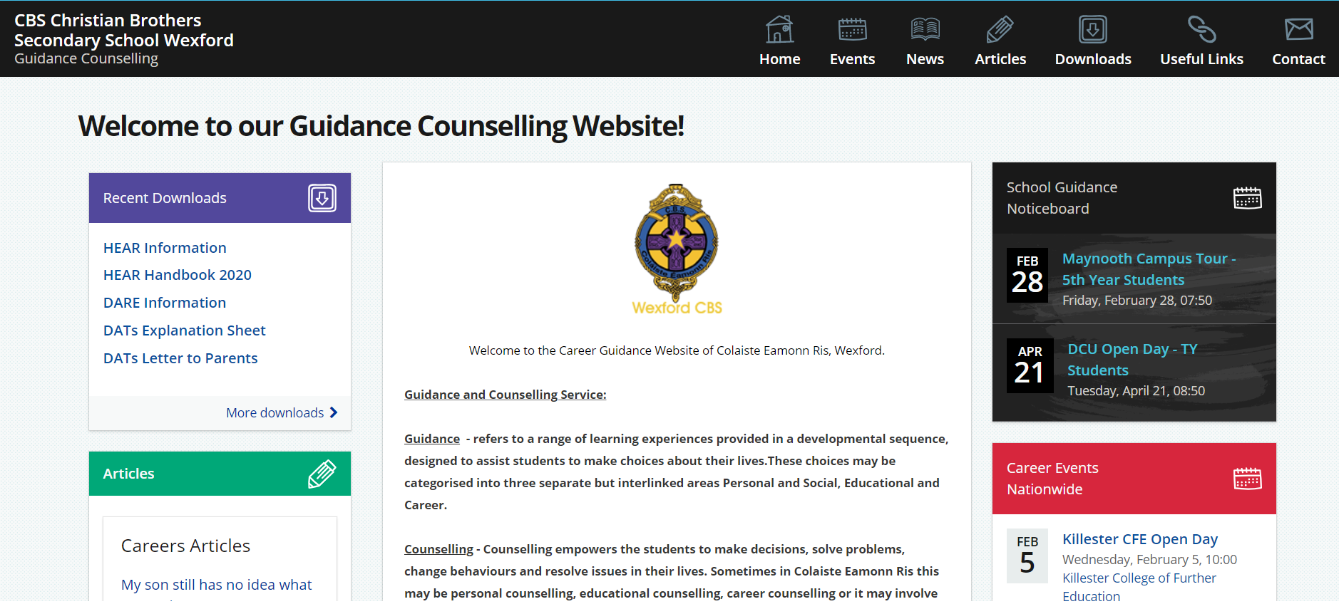
CONTACT DETAILS:
NAME: LEANNE GOFF
PHONE: 053-9141391
EMAIL: lgoff@wexfordcbs.ie
CAREER GUIDANCE WEBSITE:
https://careersportal.ie/careerguidance/office.php?school_id=705

Slide 40
CHECK & CONNECT
STUDENT ADULT MENTORING PROGRAMME

Slide 41
CHECK & CONNECT INTERVENTION
Check and Connect is an evidence-based structured adult mentoring programme that aims to promote student engagement at school and with learning. It is implemented by an adult who is a combination of mentor and advocate.
The National Behaviour Support Service (NBSS) works with schools on the planning, implementation and mentor training needed for this intervention. In NBSS partner schools teachers volunteer to become Check and Connect mentors and work to:
Build a positive relationships with a young person, including his/her family and the school
Encourage a student’s regular school participation in academic, social and emotional learning
Keep school progress a relevant issue for the student and their parents.

Slide 42
COLAISTE EAMONN RIS CHECK & CONNECT 2023/2024
Target Group = Whole school community
Areas of focus = academic, social & emotional wellbeing.
Referral options;
1) staff (teachers, year heads, tutors, SST),
2) self and
3) student/peer.

Slide 43
MENTORS 2023/2024
Ruth Ivers
Colleen Hayes
Liz Hennebry
Padraig Whitty
Fearghal Davey
Roisin Cousins
John Hegarty
Conor Byrne
Laura Argue
Shannon Roche
Erin Whelan

Slide 44
ROLE OF THE MENTOR
Each mentor links with one student, checking in weekly to discuss how he is doing and offering support in a number of ways. For example:
Providing ongoing, consistent and timely monitoring of a student’s behaviour for signs of withdrawal and disengagement: lates, absences, failing tests, conduct sheets, detentions, suspensions, lack of interest in school, resistance to learning, social isolation, etc.
Implementing timely interventions or supports to ensure student achievement and wellbeing, when appropriate. Working with other teachers, management and other support staff to help the student be successful.
Problem solving with the student when difficulties arise.

Slide 45
Restorative Practices, Positive Affirmation, Extra curricular activities
John Hegarty- Deputy Principal

Slide 46
Restorative Practice
in Wexford CBS

Slide 47
Our Target

Slide 48
Traditional Methods v restorative methods
A traditional approach to discipline focuses on the school rules that were broken, apportioning the blame and makes the wrongdoer accountable by punishing them.
Restorative practices focuses attention on the relationships that have been damaged, what needs to happen on all sides to rebuild these relationships and what can be learned from the experience.

Slide 49
A change of perspective
Traditional Discipline | Restorative Approach
Viewed in terms of rule-breaking | Viewed in terms of harm done to individuals
Focus on establishing blame or guilt | Focus on establishing responsibility and way forward
Authority figure with power to decide on penalty | Dialogue involving all parties in the incident
Accountability=getting punished | Accountability = working to put things right
Punishment to deter | Repair, apology and reparation
The needs of those affected are often ignored | The unmet needs behind the behaviour are addressed
Wrong doer feels hard done by and bitter | Wrongdoer has opportunity to face up to poor decisions
Victim has no involvement and feels powerless | Victim has involvement in process and contribution to outcome
Resentment, denial, anger, fear, revenge are common during and after process | Empowerment, honesty, openness, opportunity to move on, peace of mind after process

Slide 50
A whole school approach
Looking at our school mission statement, where our primary objective is to “Develop responsible individuals”, this is an approach that we aim to permeate through all aspects of school life in Wexford CBS, not only thinking in terms of the restorative approach for when things go wrong
We aim to highlight the proactive positive elements of the school and build good relationships which are so important.
The Restorative approach overlaps with the work the school is already doing to as it says in develop active and more participatory teaching and learning styles, social and emotional skills, behavioural plans, community cohesion, greater student voice and participation and preventative policies to minimise the risk of bullying and other areas of conflict within the school.

Slide 51
Restorative Questions
What happened?
What were you thinking at the time?
What are you thinking/feeling now?
Who has been affected by this?
What do you need now to move on?
What needs to happen now so the harm can be repaired?

Slide 52
Target outcomes of Restorative Practices
The victim is able to feel safe again
The focus is on harm to people and acceptable behaviours. This reduces the likelihood of blame or denial.
The wrongdoer and his/her family are more likely to accept responsibility for what has happened
The wrongdoer will develop a greater empathy from the experience and is less likely to re-offend as a result
The offending student will be reintegrated into the wider school community

Slide 53
Positive Affirmation
in Wexford CBS

Slide 54
Positive Affirmation in Wexford CBS
Leadership opportunities
Positive Affirmation Committee (PAC)
Merit Points
Your part in Positive Affirmation

Slide 55
Extra Curricular activities in Wexford CBS
Leadership opportunities
Students Council
Young St Vincent de Paul
Debating/Public Speaking
Young Entrpeneur/Enterprise opportunities
Christmas Fair
Talent show
Tae agus Ple
1st Year Tour

Slide 56
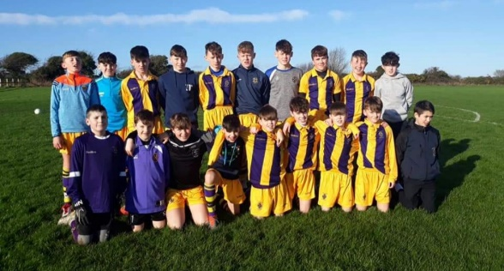
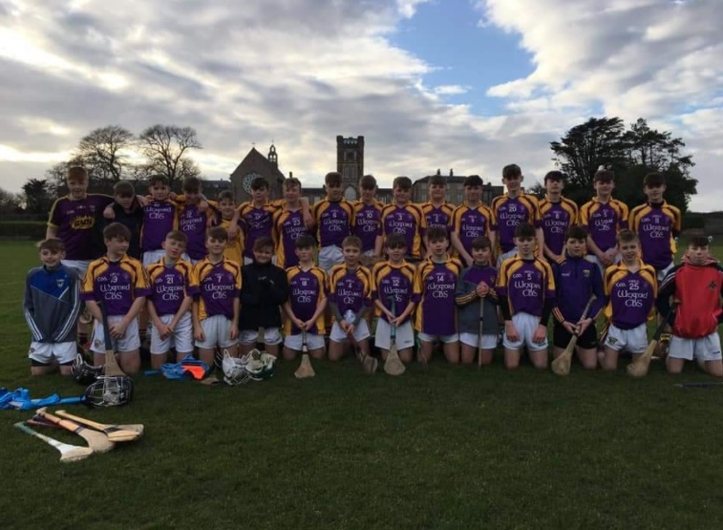
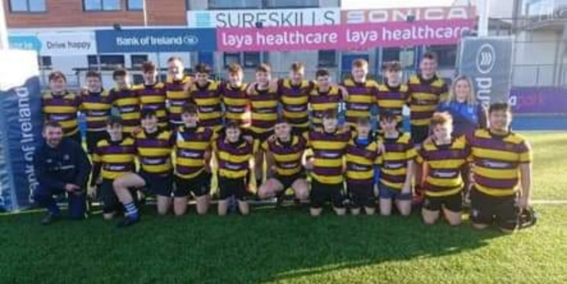
Extra Curricular activities in Wexford CBS
School choir
Cycle Against Suicide
Sport in 1st Year
Hurling
Gaelic Football
Soccer
Basketball
Rugby
Athletics

Slide 57
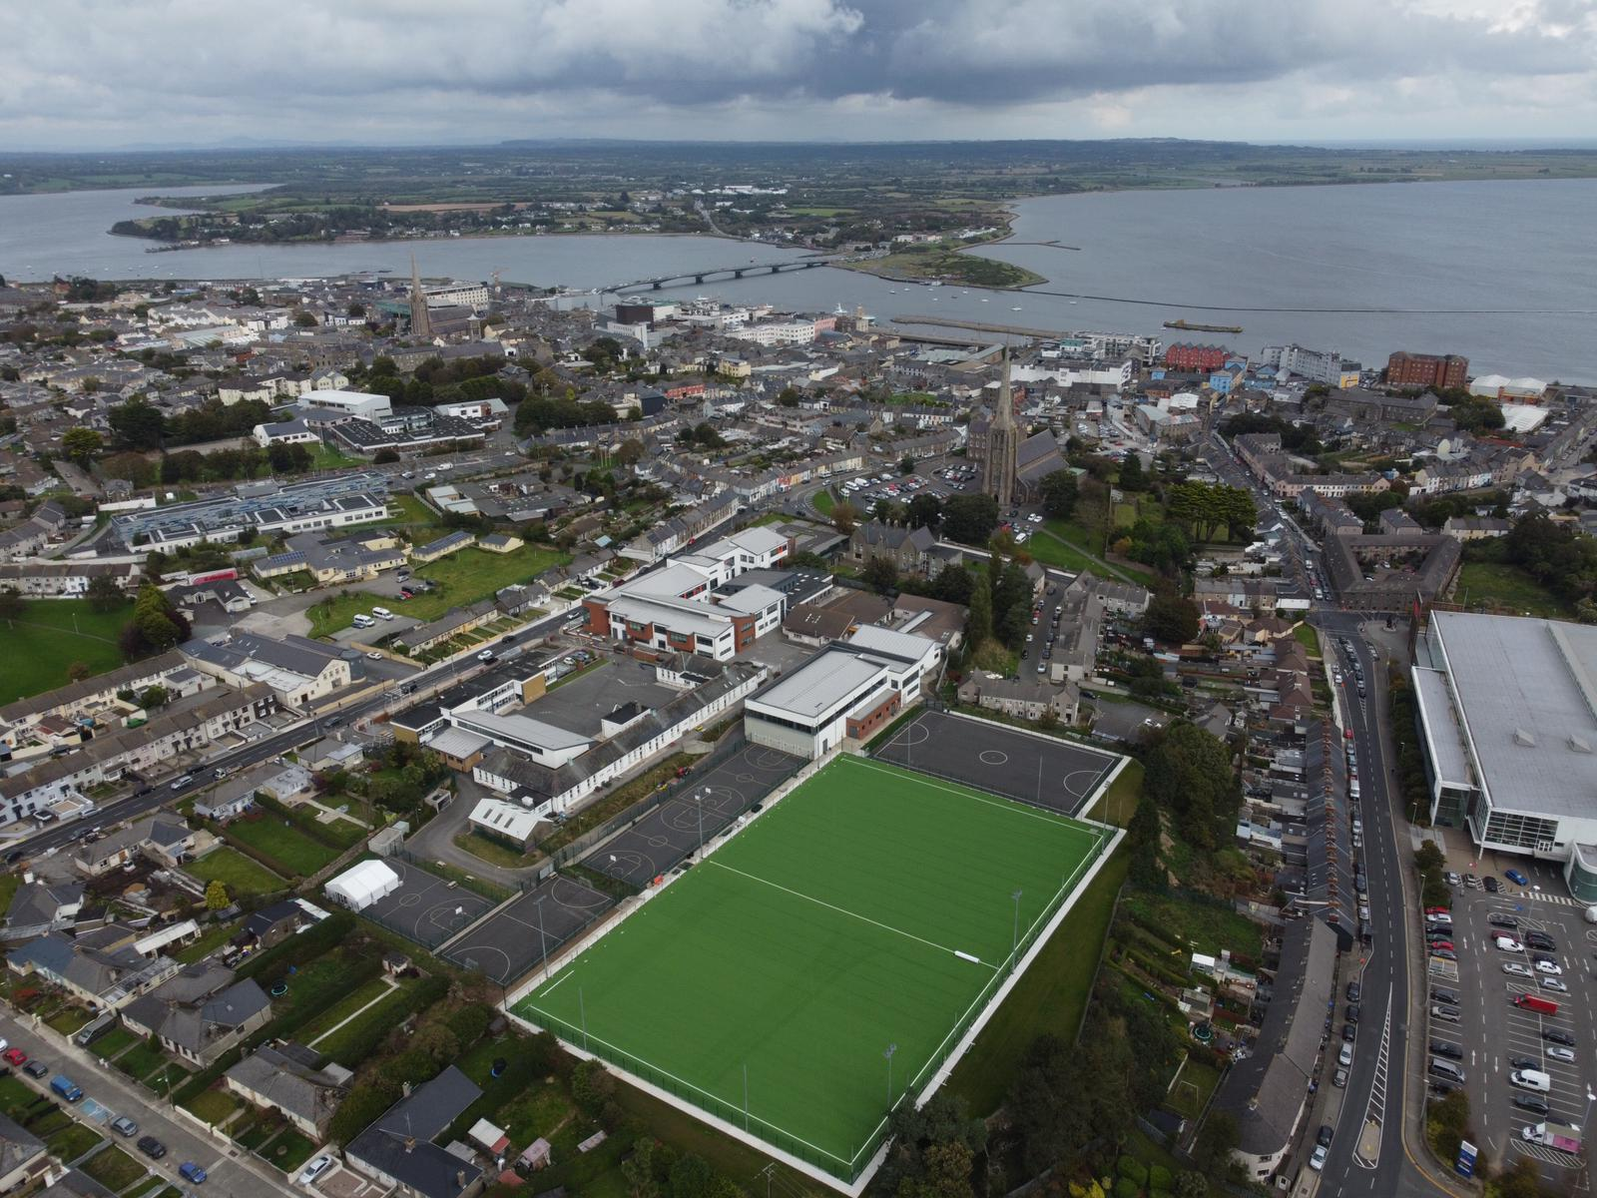
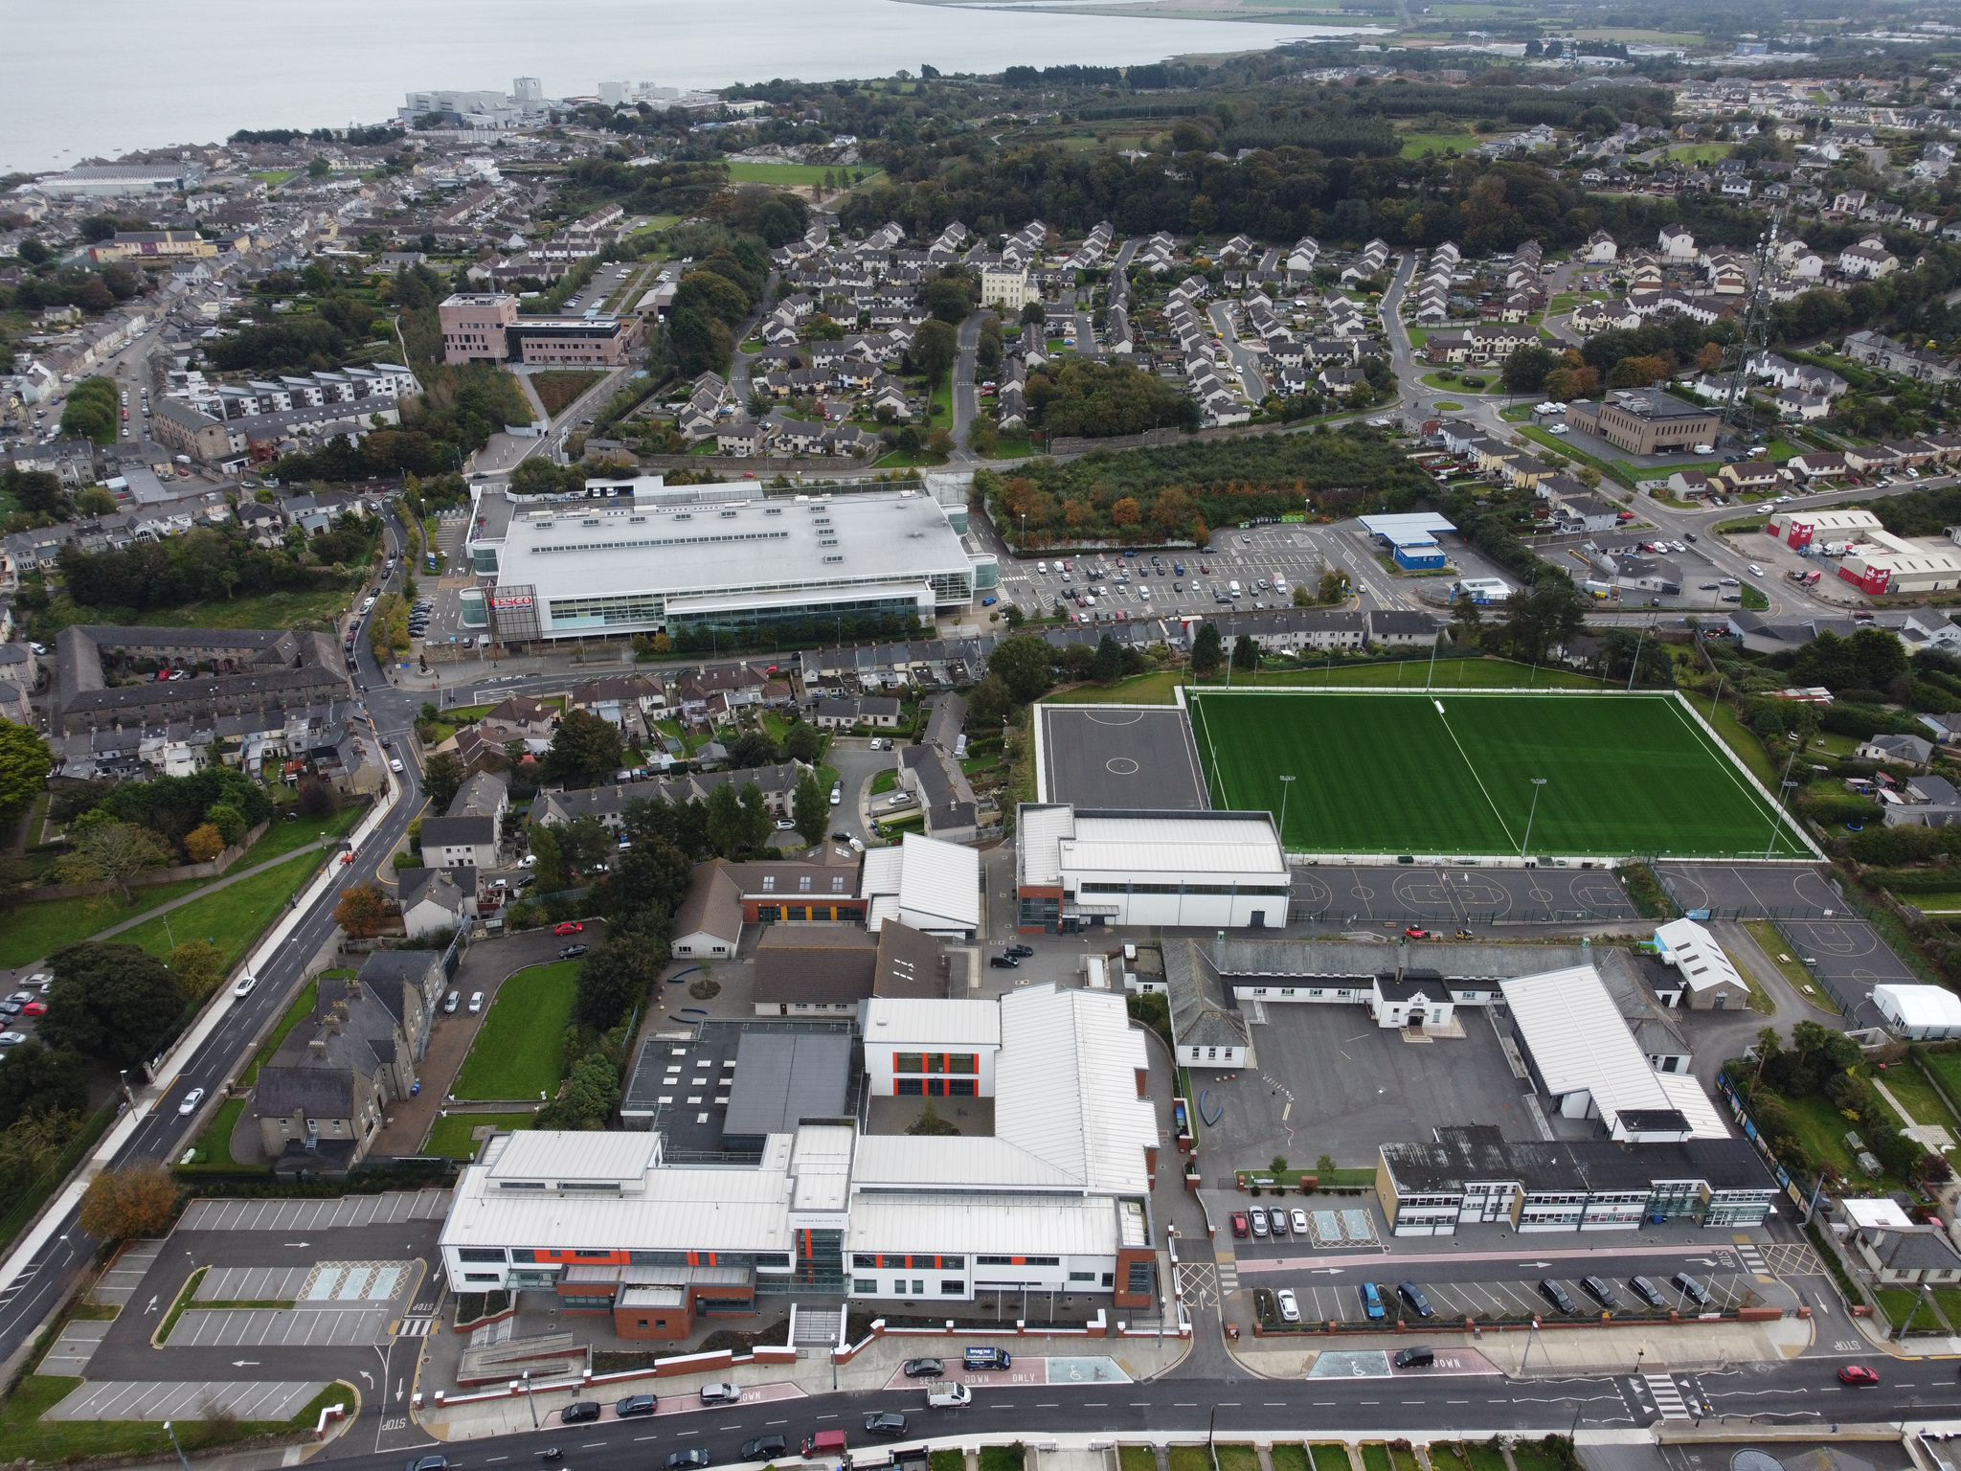
New CBS Astroturf Pitch

Slide 58
Digital Communications
John Nolan

Slide 59
Click here to create your password

Slide 60
Enter user name here
Enter last 4 digits of your mobile here

Slide 64
MAKING AN INFORMED CHOICE:
What subject might they like? (use the fact sheets)
What subjects might they need?
Balanced choice of subjects
KEY ADVICE:
PICK SUBJECTS THEY THINK THEY WILL ENJOY!!

Slide 65
Student Devices for September 2023
Fearghal Davey

Slide 66
Why is Coláiste Éamonn rís introducing devices for first Years?
January 2022 – staff were surveyed for feedback on E – Learning in teaching and learning
E – Learning is the use of digital technologies for teaching and learning.
the majority of staff were happy with e-learning in the school some issues arose around the use of mobile phones and students not having access to a device
Difference between word etc on phone vs laptop/computer’’
‘Small screen, hard for students to work’
‘Do not get the benefit of all Office 365 apps’
A prescribed School Device system would be safe and easier to monitor
Following the results and issues raised by the survey, it was agreed to survey staff on whether to introduce student devices for incoming First Years.

Slide 67
Do students currently use their own device (mobile phone) in your classroom for digital learning? – February 2022
Yes – 35 - 87.5%
No – 5 - 12.5%

Slide 68
Student Devices in the Classroom, Staff Survey February 2022

Slide 69
STUDENT DEVICES-PARENTAL SURVEY

Slide 70
NCCA Key Skills of Junior Cycle and digital technology with students
As a result, the NCCA have identified 8 key skills that students must learn and focus on in Junior Cycle.
The NCCA also outlines that “Working with digital technology forms a part of each of these skills”, therefore planning and using technology to build students digital skills forms a fundamental part of learning and assessment in all Irish schools to prepare them with the skills they will need for the world of work today and into the future

Slide 71
Looking at Our School 2022: A Quality Framework for Post-Primary Schools
Looking at Our Schools 2022 makes refence to digital technologies
Statements of practice – Leadership and management
Domain 1: Leadership and Management
Standards | Statement of Effective Practice | Statemnets of highly effective practice
Promote a culture of reflection, improvement, collaboration, innovation and creativity in learning, teaching and assessment | The principal and other leaders in the school support teachers to use digital technologies in their learning, teaching and assessment practices, and evaluate the effectiveness of the use of these technologies. | The principal and other leaders in the school lead a process of empowering teachers to embed digital technologies in their learning, teaching and assessment practices, and regularly evaluate the effectiveness of the use of these technologies

Slide 72
Digital strategy for schools 2027
The Department of Education has published a new Digital Strategy for Schools. The purpose of this new Strategy is to ensure that young people in our schools, can benefit as much as possible from digital technologies.
The new Strategy aims to support all pupils and students to develop digital skills and benefit from the potential of digital technology, while also staying safe and well when online. The introduction of student devices should help students develop digital skills.

Slide 73
Questions
Any queries or clarification needed

Slide 74
Contact details
principal@wexfordcbs.ie
jhegarty@wexfordcbs.ie
lgoff@wexfordcbs.ie
hturner@wexfordcbs.ie
jnolan@wexfordcbs.ie
adarcy@wexford.ie
mconnell@wexford.ie
fdavey@wexfordcbs.ie

Slide 75
Finally
Reminder re various forms to be returned
Text message on how to download the VS Ware app will be sent tomorrow
Second text message with username - create your own password
Subject Choice on VS Ware
Wriggle Pack will be forwarded in the coming days
THANK YOU

